Slide 1
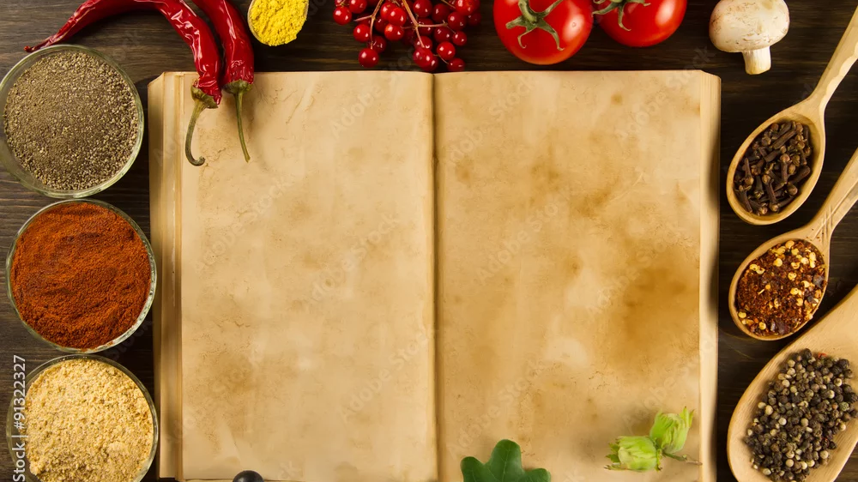
Recipe Company RDF
Web of Data
12.12.2025
Vinzent Aschir and Balaji Govindarajan

Slide 2
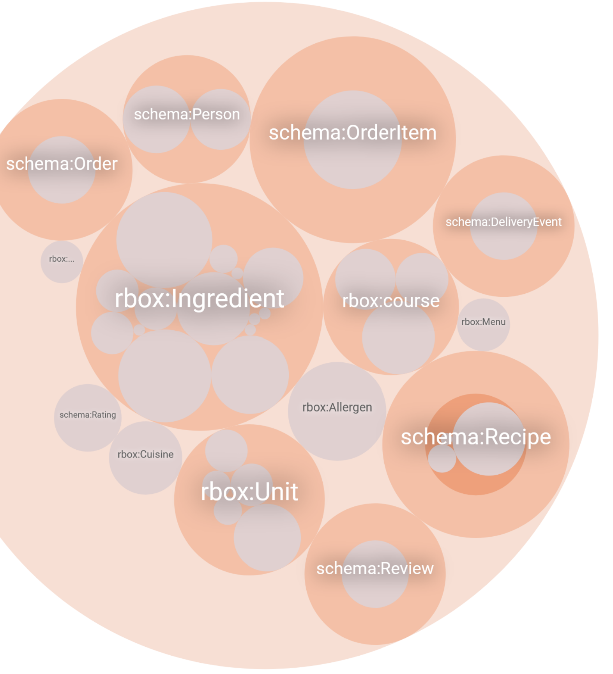

Overview
# 1643 triple
# 14 Recipes
# 60 Ingredients
# 3 Menus
# 15 Allergens
# 11 Units
#2 Subscription Plans
# 5 Customers
# 4 Couriers
Notes:
Created a bunch of classes with initialsiations

Slide 3
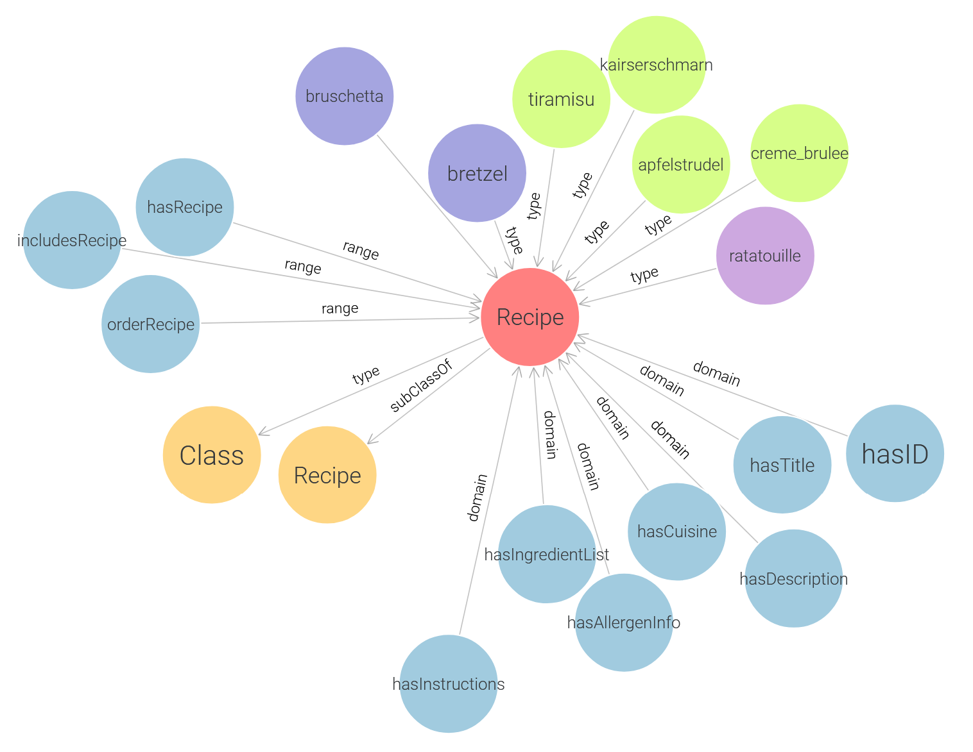
Notes:
Instance hold up to 9 properies
string values: Instructions, servings, or ID
- external implementation – schema: hasID or prepTime
properties to the company part
One property to menu part
Schema recipe
Instances of recipe colored belong to subclass:
Blue Apetizers
Green desert
Purple main dish

Slide 4
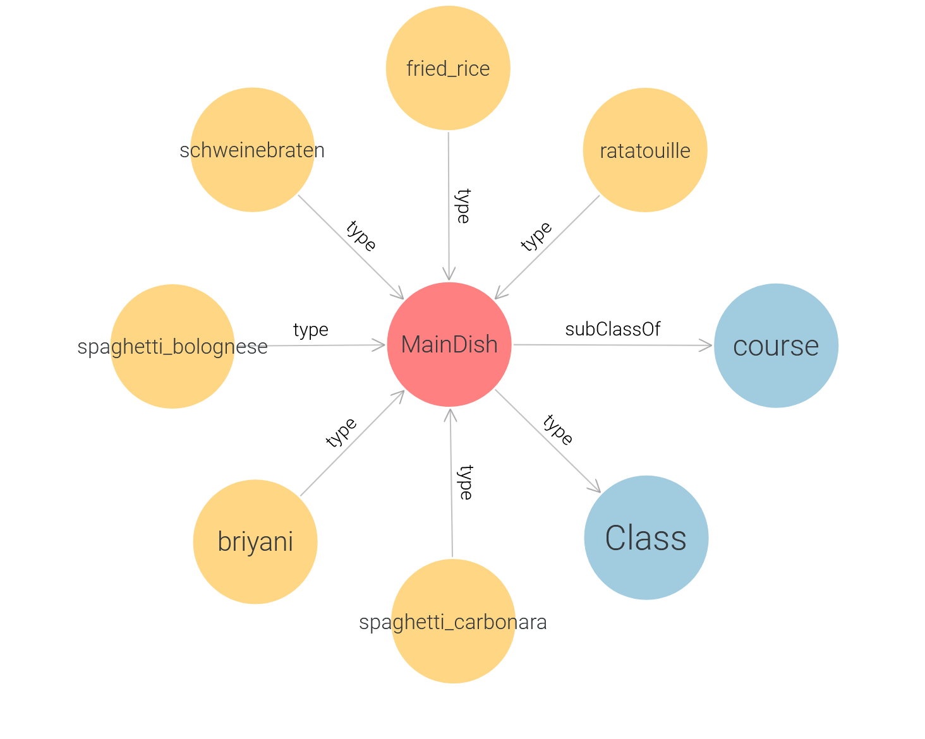
Notes:
Not all instances and Properties of recipe are shown.

Slide 5
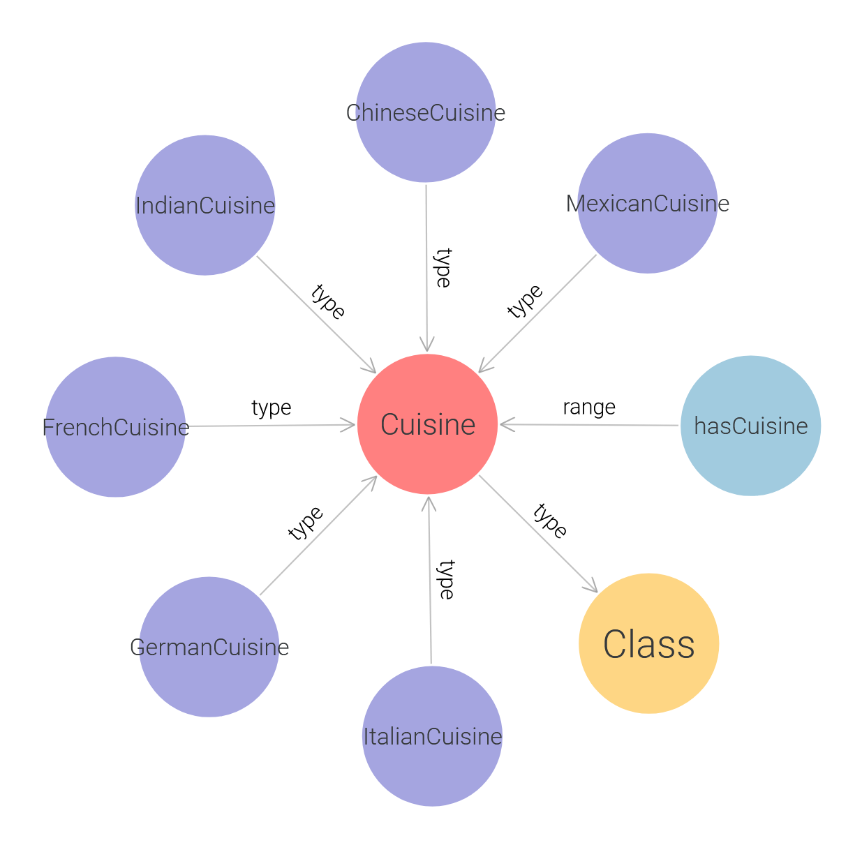
Notes:
Recipe Has Cuisine cuisine
6 subclasses

Slide 6
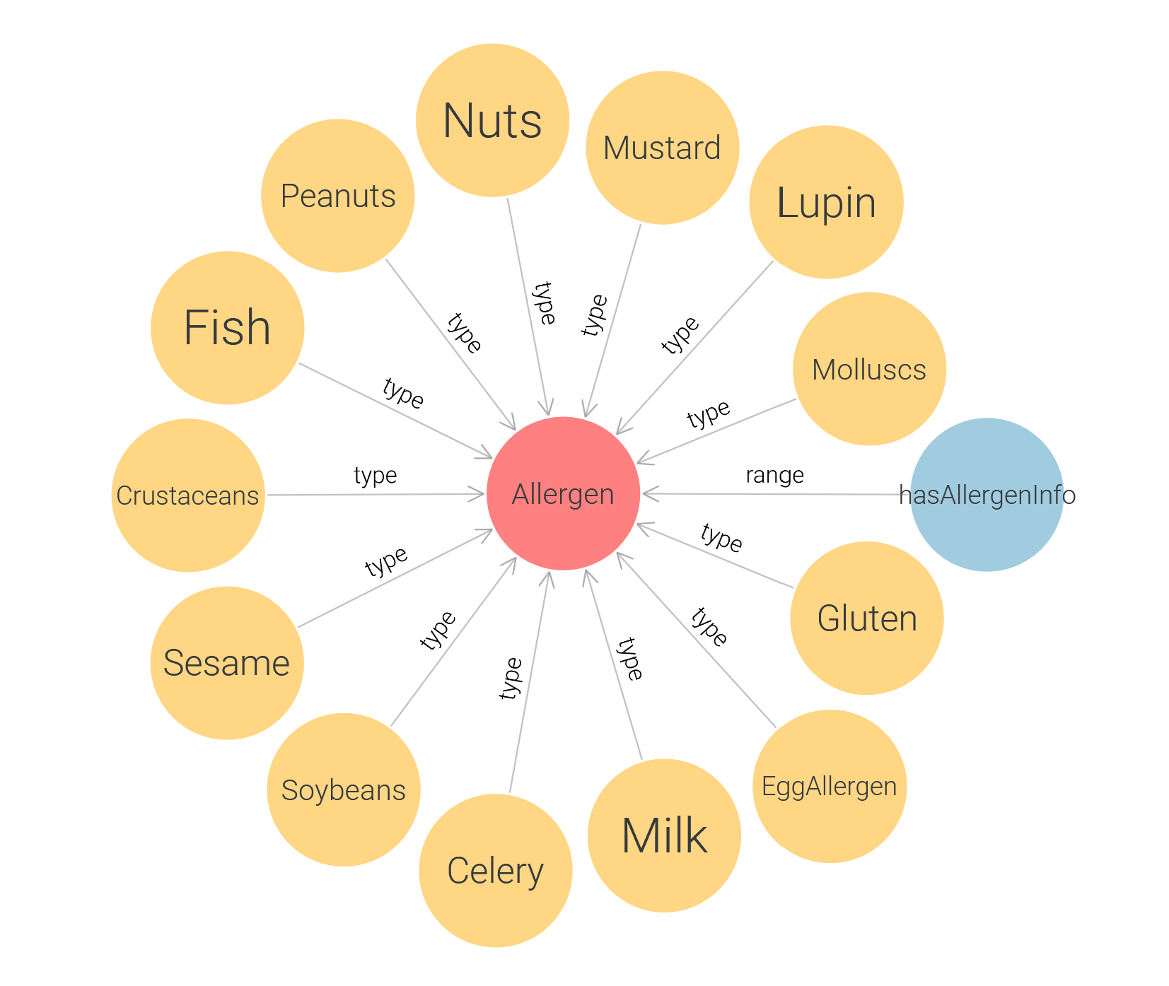
Notes:
15 Allergens
13 in Initialisation

Slide 7
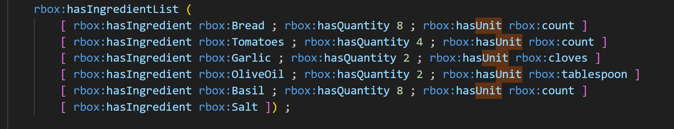
rbox:hasIngredientList bound-Ingredients
Ingredient
Amount(decimal) – optional
the unit – optional
Notes:
Recipes hold with has Ingredient list – instance that holds
Triples:
Ingredient instance
A decimal quantity (optional)
Unit

Slide 8
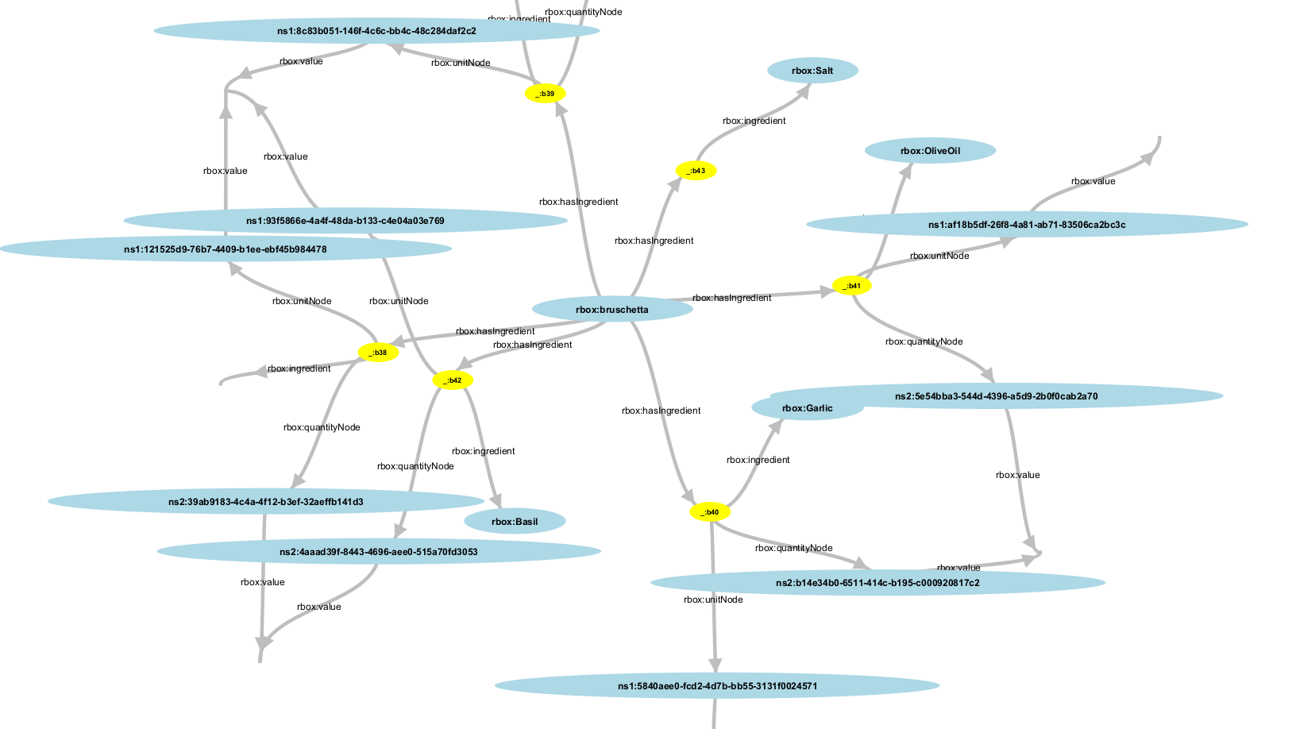

Slide 9
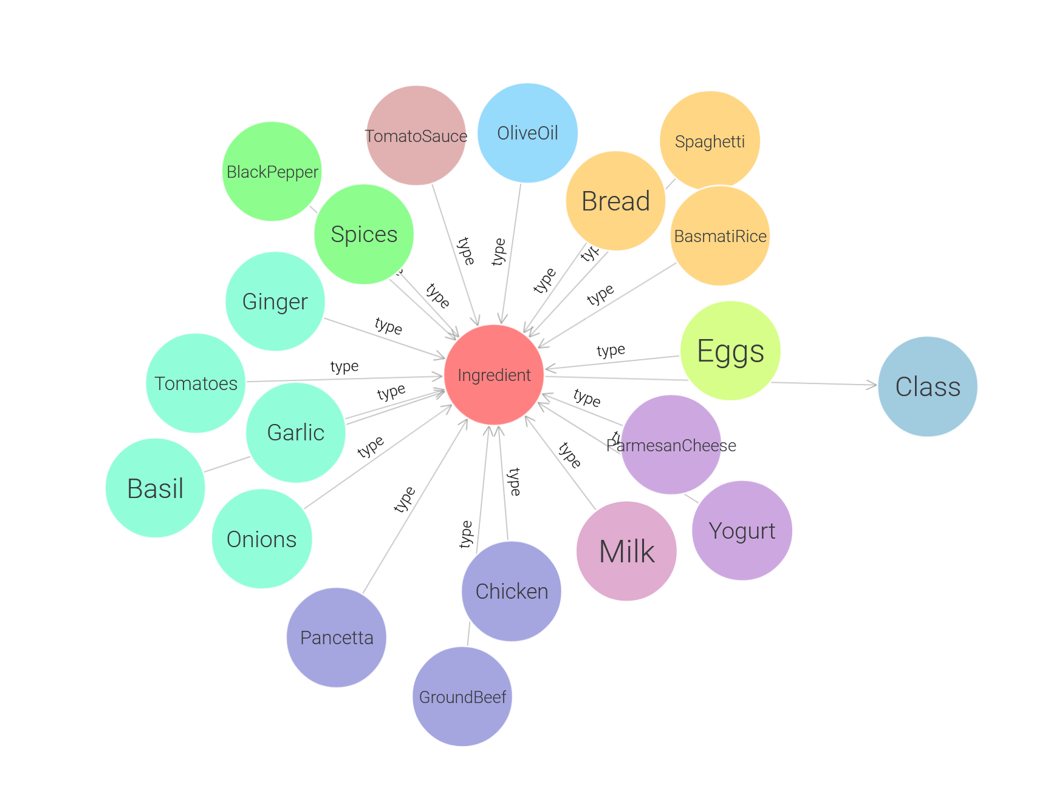
Notes:
Subclasses:
Spices
Eggproducts
Sauces
Meat
DiaryProducts
Vegtebales
16 subclasses / categories
60 ingredients.

Slide 10
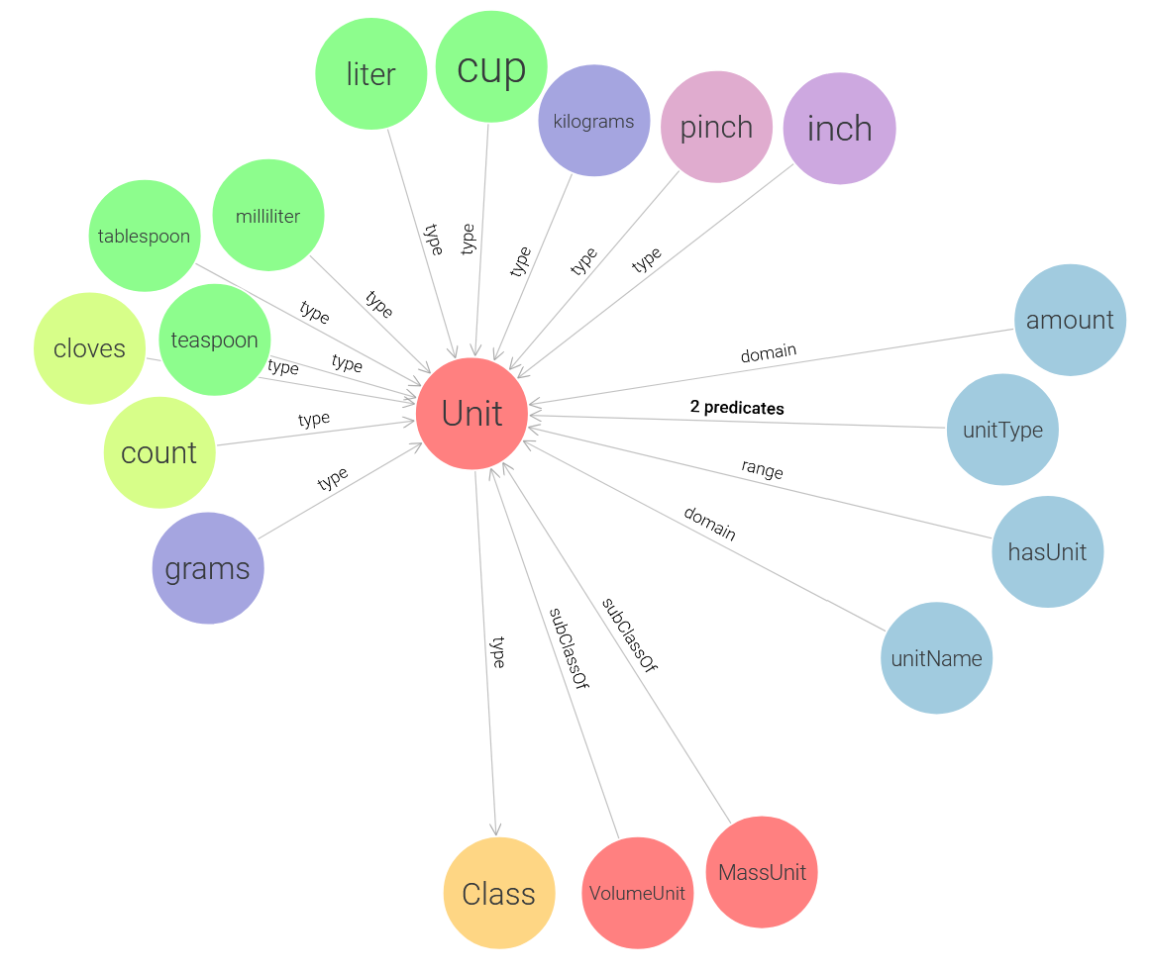
Notes:
4 subclasses
volume
Count
Length
Couple of proerties
Instances of the subclasses

Slide 11
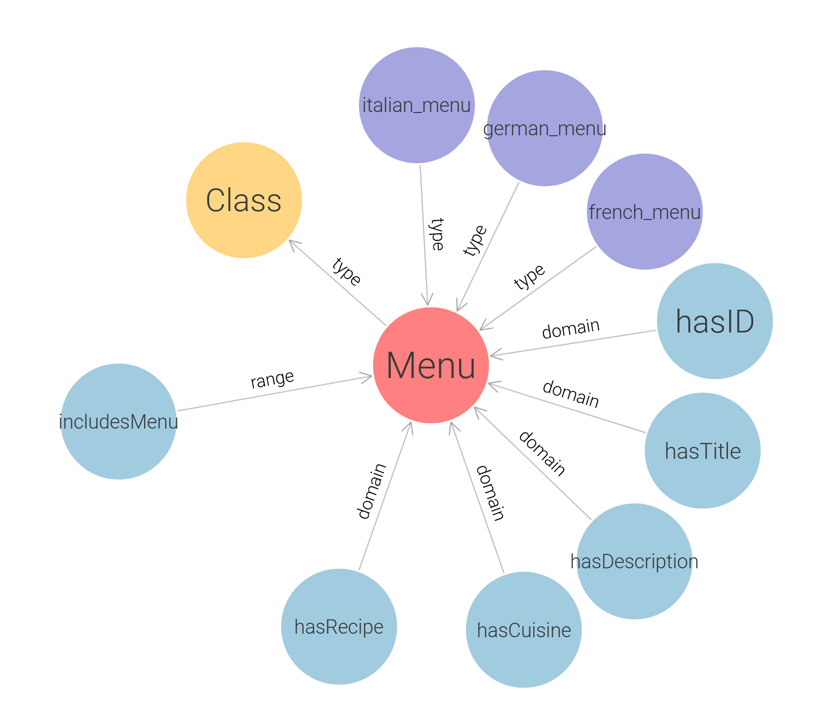

Slide 12
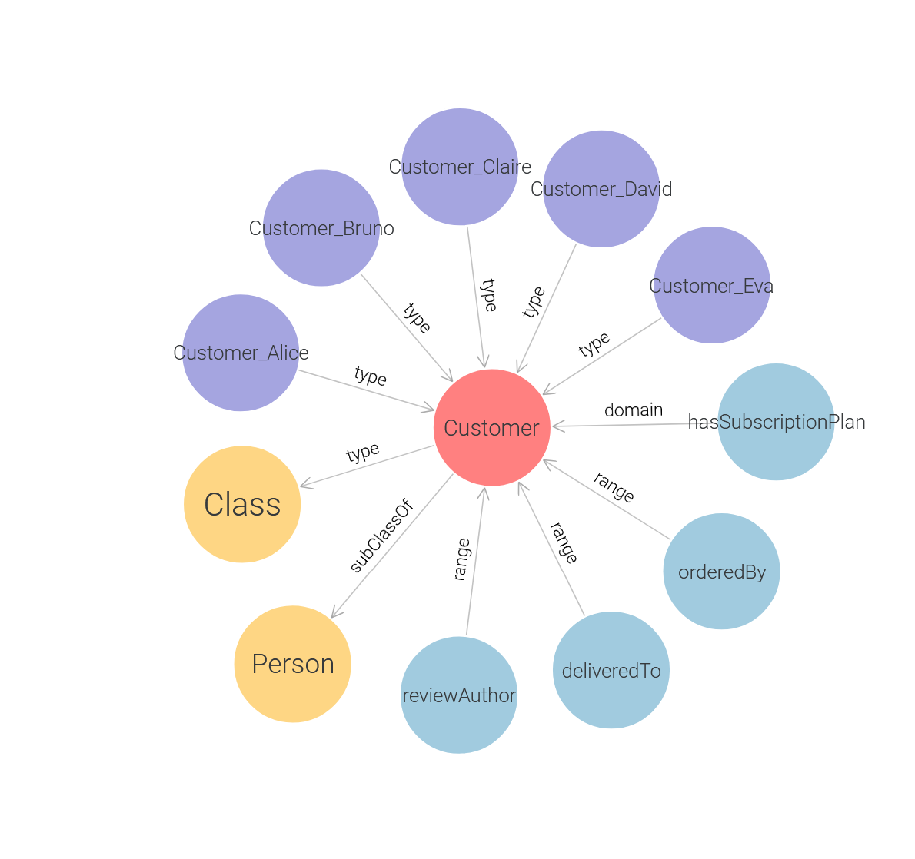

Slide 13
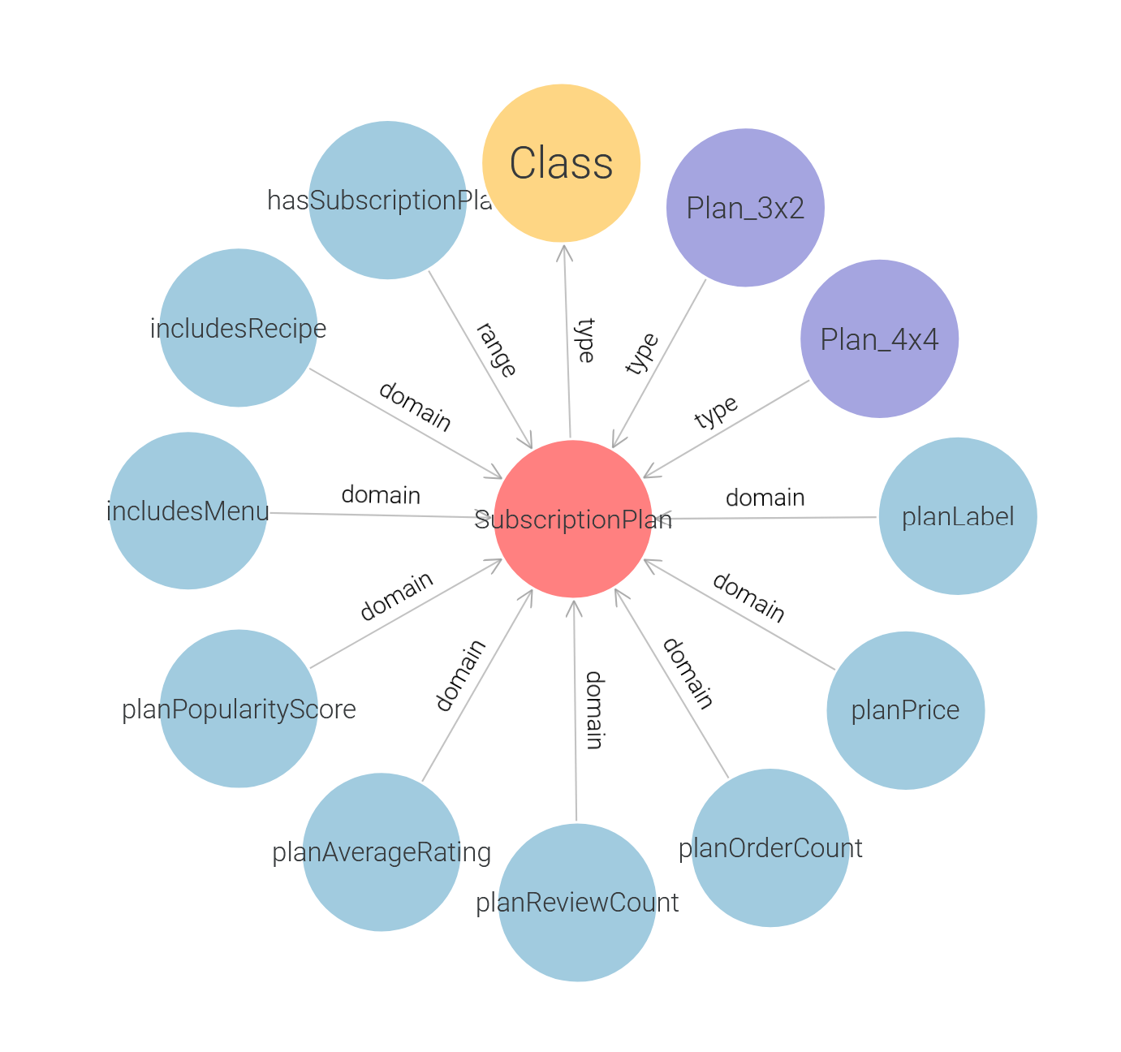

Slide 14
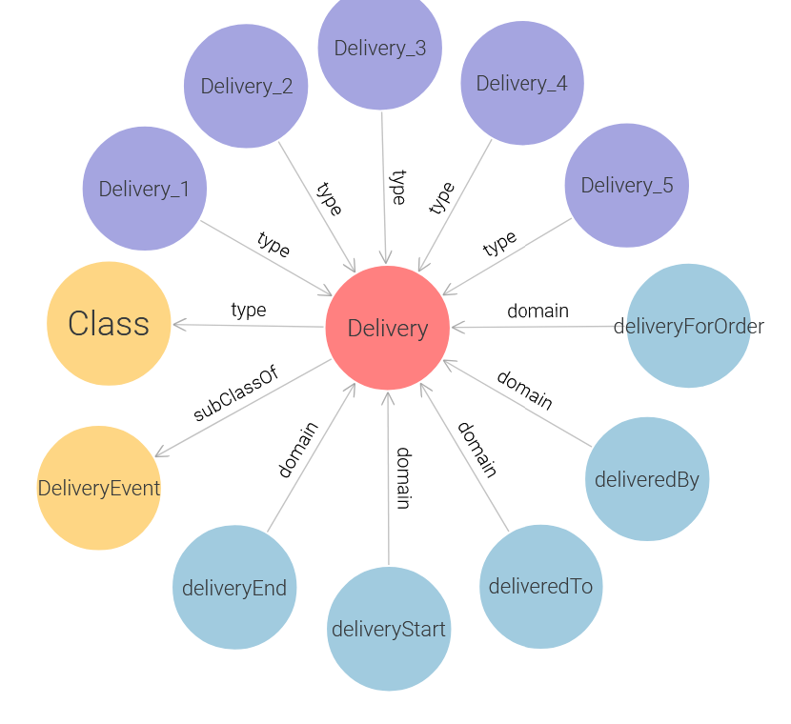

Slide 15
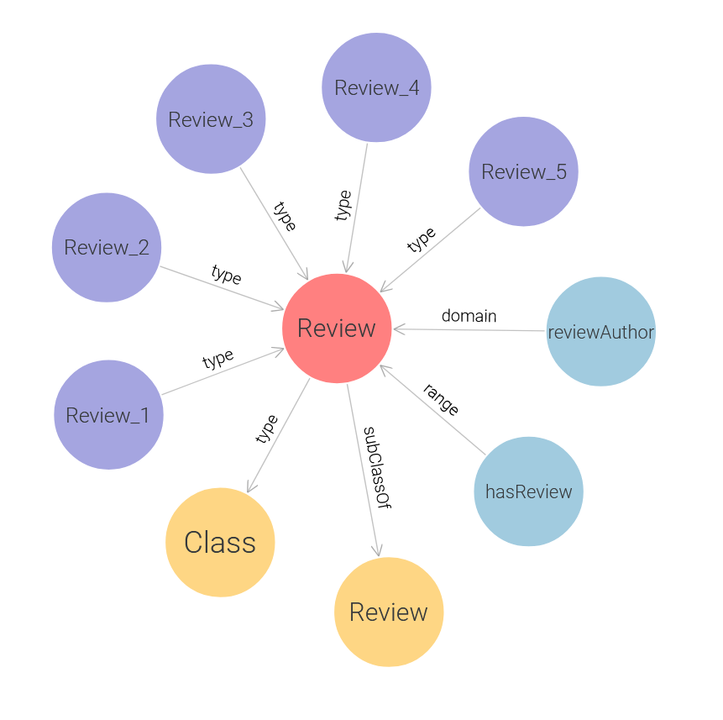

Slide 16
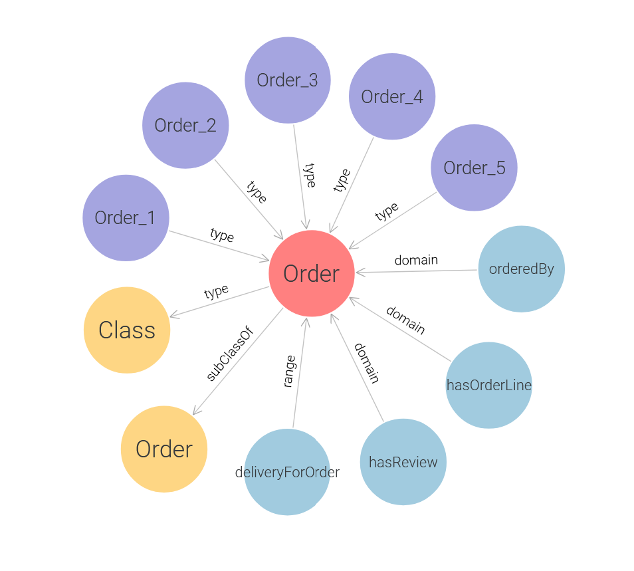

Slide 17
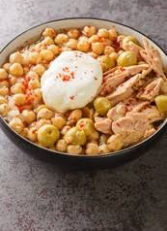
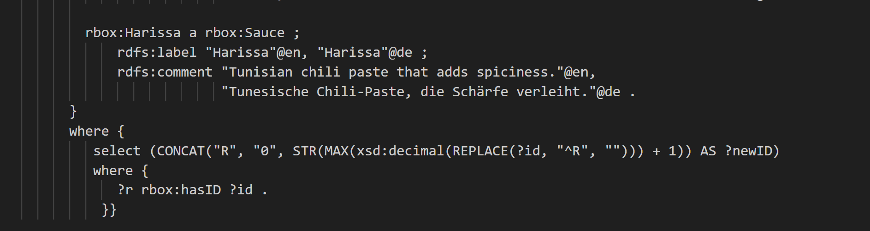
Querry 1: add the new tunisian recipe Lablebi
Calculate the newest recipe iD:
Using regulare expressions
Adding missing Ingredients and Cuisine

Slide 18
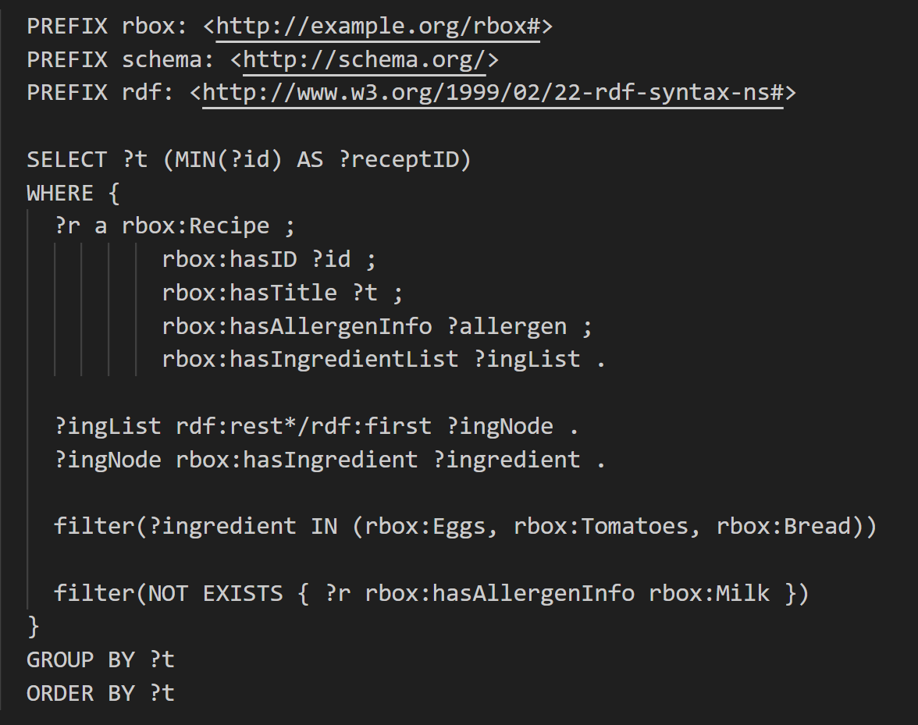
Querry 2
I have tomatoes, eggs and bread in my fridge.
Is there a recipe where i could use at least one of them for cooking,
but that respects my allergy against milk-products?

Slide 19
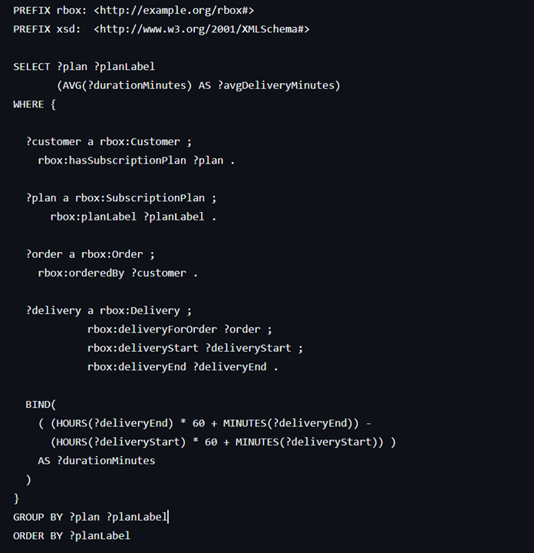

Querry 3
How long does delivery usually take for each subscription plan on average?

Slide 20
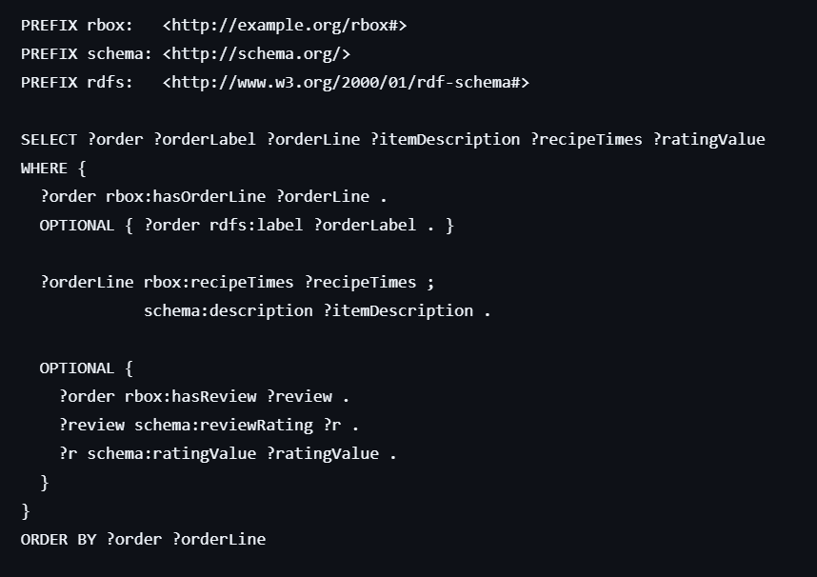

Querry 4
Can you show me, for every order, how many portions people ordered and what rating they gave?

Slide 21
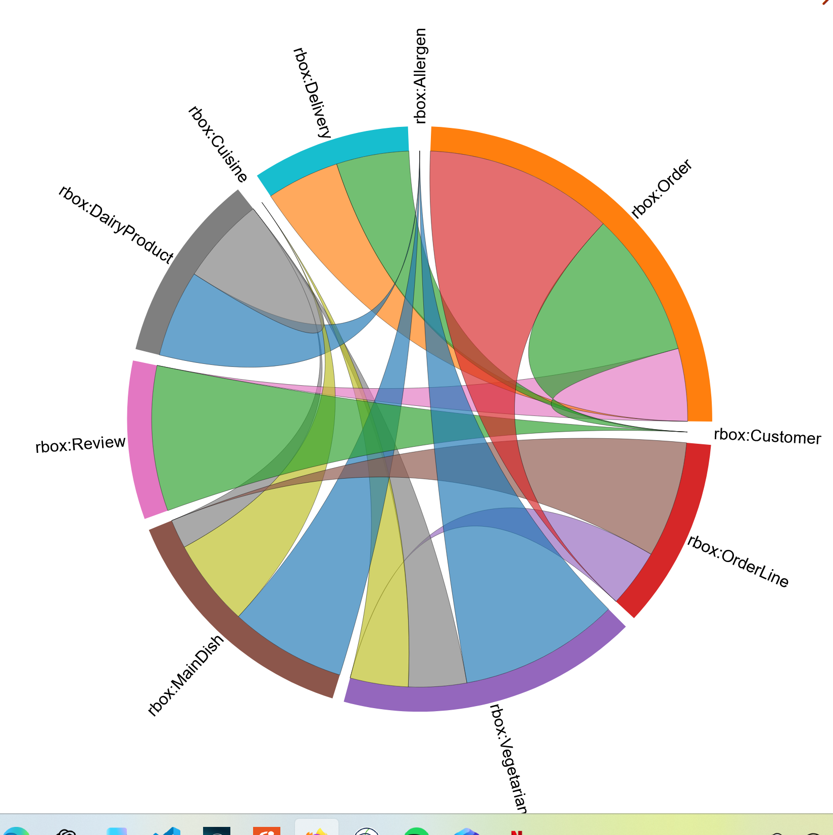
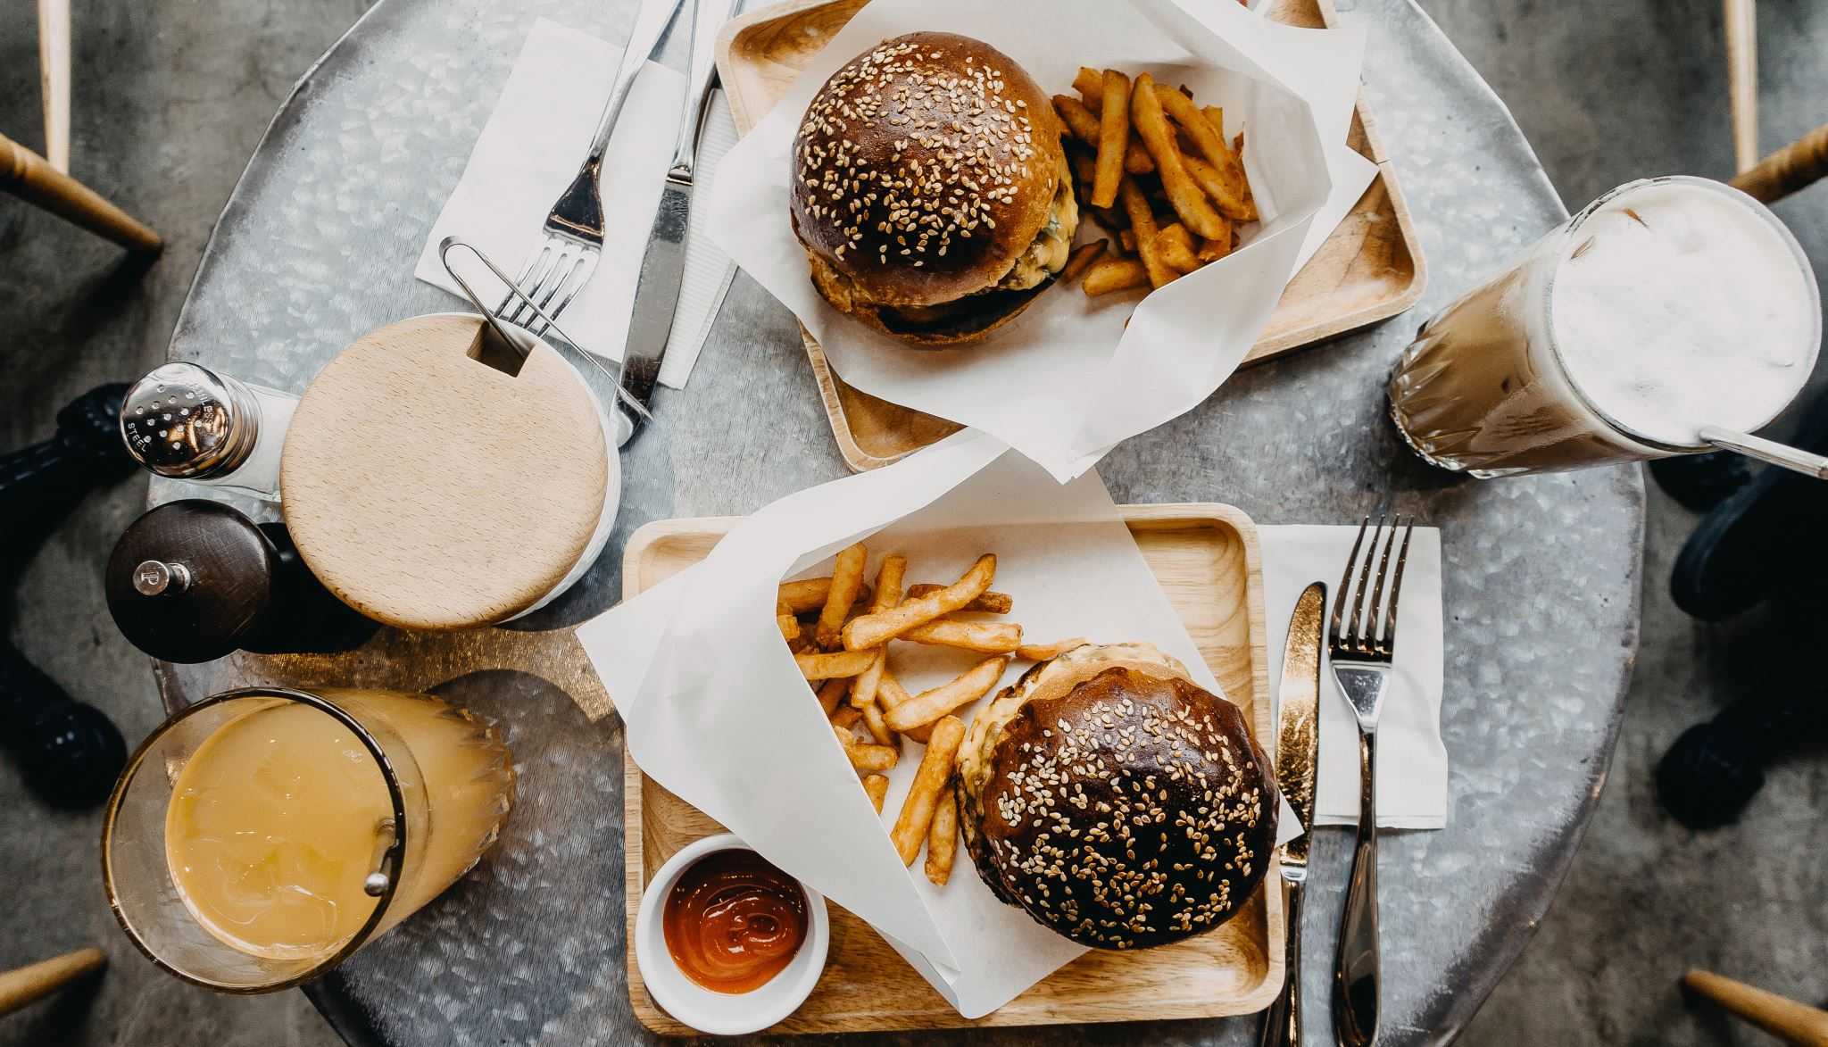
Bon Appetit

